Slide 1



Microvascular Dysfunction
Implications for Cardio-Oncology
Ninian N Lang
Professor of Cardiology and Cardio-Oncology, University of Glasgow, Scotland
Hon. Consultant Cardiologist, Beatson Cancer Centre and Queen Elizabeth University Hospital, Glasgow, Scotland
11th Annual COVADIS Summit; Amsterdam, 29th August 2023

Slide 2
Disclosures:
Grant support (paid to my employer, the University of Glasgow):
Roche Diagnostics, Boehringer Ingelheim and AstraZeneca
Consultancy fees:
AstraZeneca, Akero, Myokardia, CV6 Therapeutics,Pharmacosmos and Vifor Pharma
Speaker’s fees:
Jazz Pharma, Roche, Pfizer and Novartis

Slide 3
Keeping up with the successes in oncology!
Cancer Research UK
Sturgeon et al Eur Heart J, 2019

Slide 4
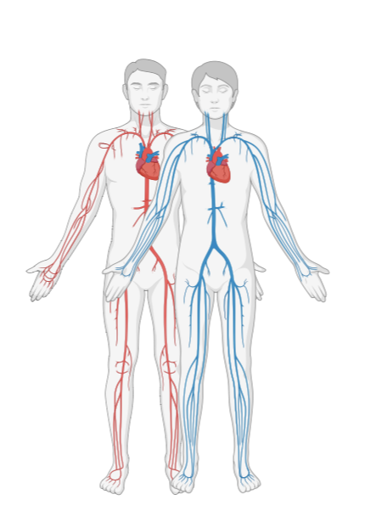
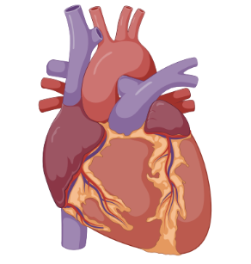
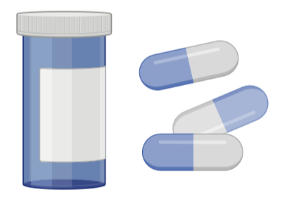
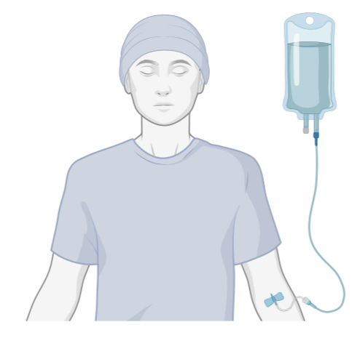
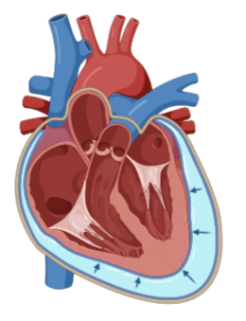

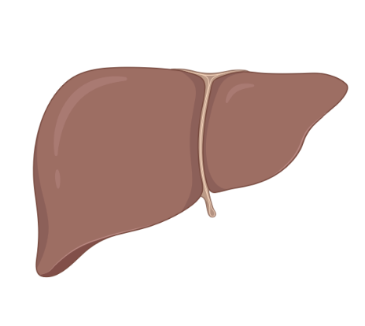
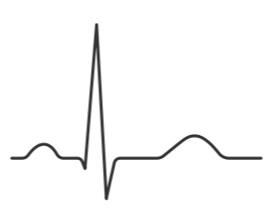
Cardiovascular Toxicity of Cancer Therapies
MYOCARDIAL
Left ventricular dysfunction
Heart failure
Myocarditis
Infiltration
Restrictive cardiomyopathy
VASCULAR
Atherosclerosis
Arterial thromboembolism
Venous thromboembolism
Systemic hypertension
Proteinuria
Pulmonary hypertension
PERICARDIAL & VALVULAR
Pericardial effusion
Pericarditis
Pericardial constriction
Valvular heart disease
METABOLIC
Hyperlipidaemia
Hyperglycaemia
ELECTRICAL
Bradyarrhythmia
Tachyarrhythmia
QT prolongation

Slide 5
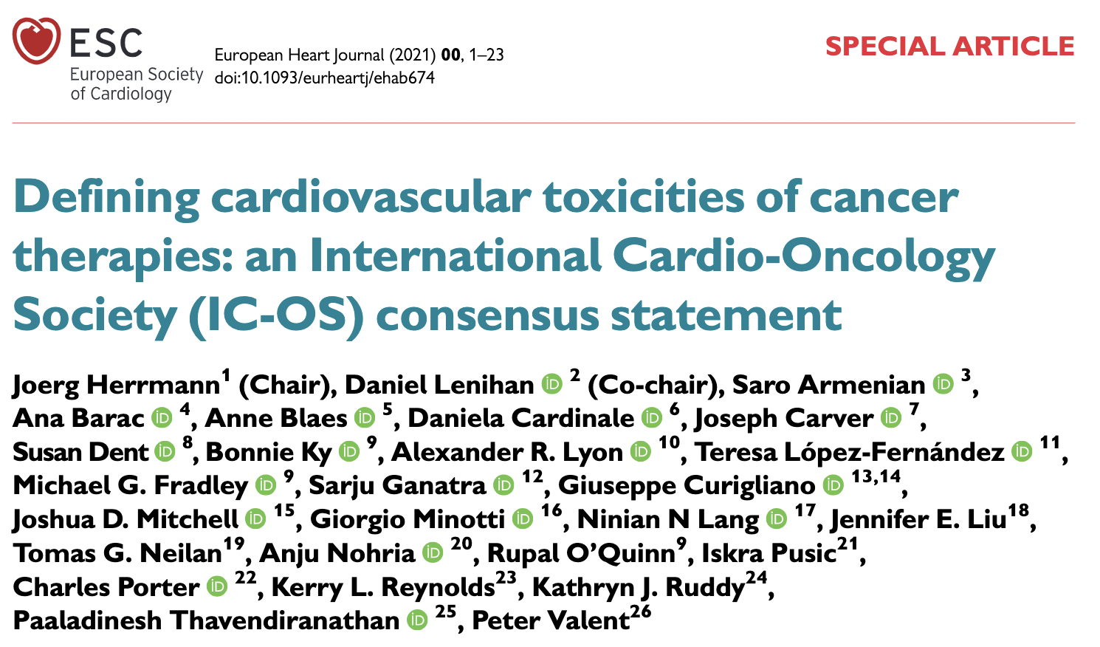
Consensus Definition of Cardiotoxicity
INCLUDING:
MICROVASCULAR DYSFUNCTION
(SYMPTOMATIC AND ASYMPTOMATIC)

Slide 6
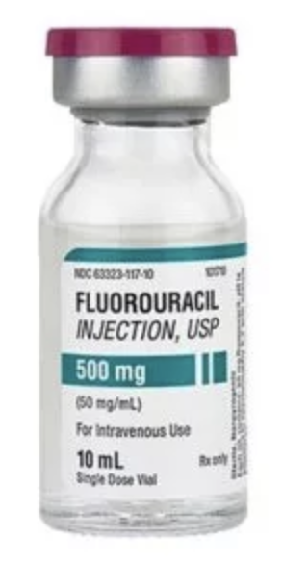

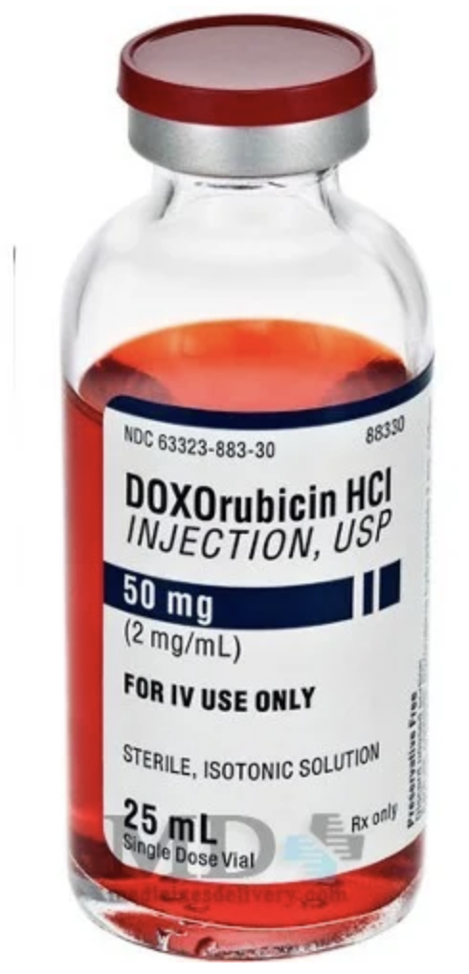
Well Known Offenders?
ACUTE
CHRONIC
???

Slide 7
ANGIOGENESIS INHIBITION:
VEGF Signalling Pathway Inhibitors
Used in the treatment of:
- Renal ca
- Thyroid ca
- Non small cell lung ca
- Sarcoma
- Colorectal ca
- Neuro-endocrine tumours
- GIST
For example:
Bevacizumab
The ‘ibs’
  Sunitinib, Pazopanib, Axitinib
  Etc…

Slide 8
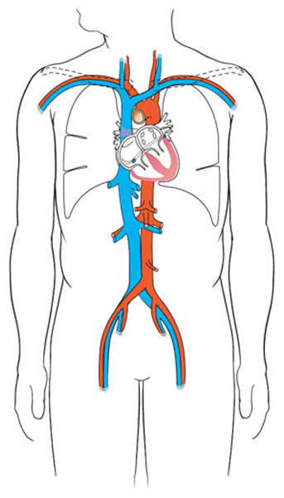
VEGF Signaling Pathway Inhibitor CV Toxicities
Hypertension
Up to 80%
LVSD
3-15%
Proteinuria
Any grade: 20-65%
Nephrotic range: 2-3%
MI
1.4-1.7%
↑QT
4.4%
And potential interruption of optimal cancer therapy….
Dobbin SJH… Lang NN. Heart. 104(24):1995-2002

Slide 9
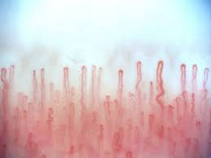
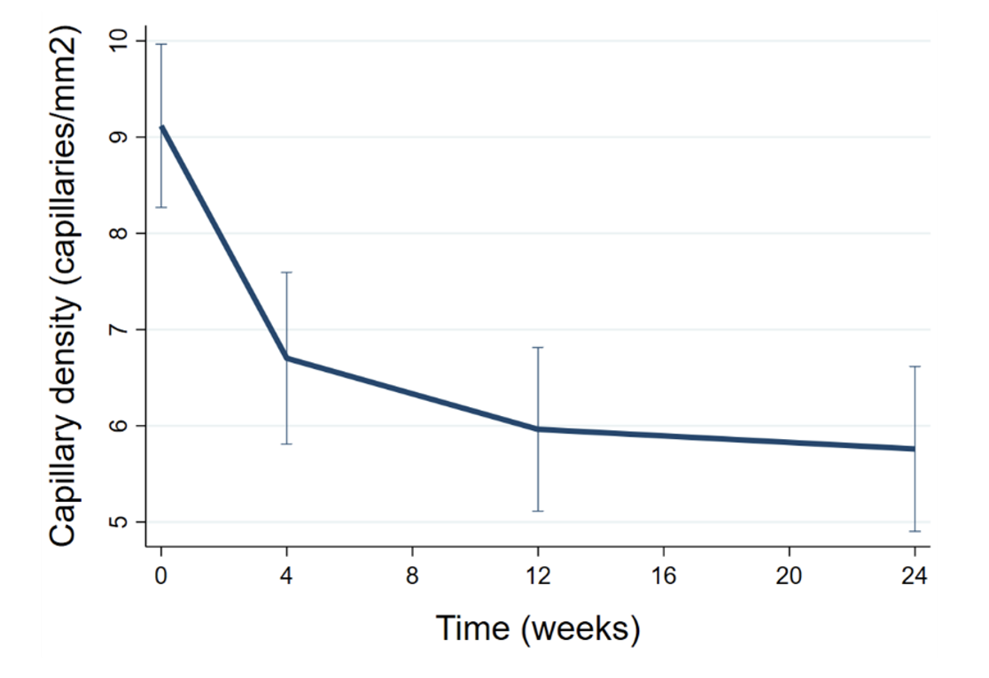
Nailfold Capillary Density:
Patients Treated with VEGFi (n=90)
Dobbin SJ, Lang NN. Unpublished.

Slide 10
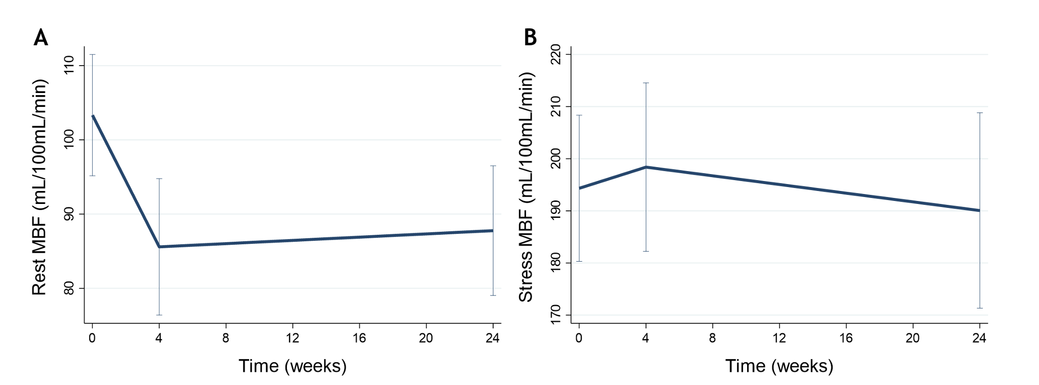
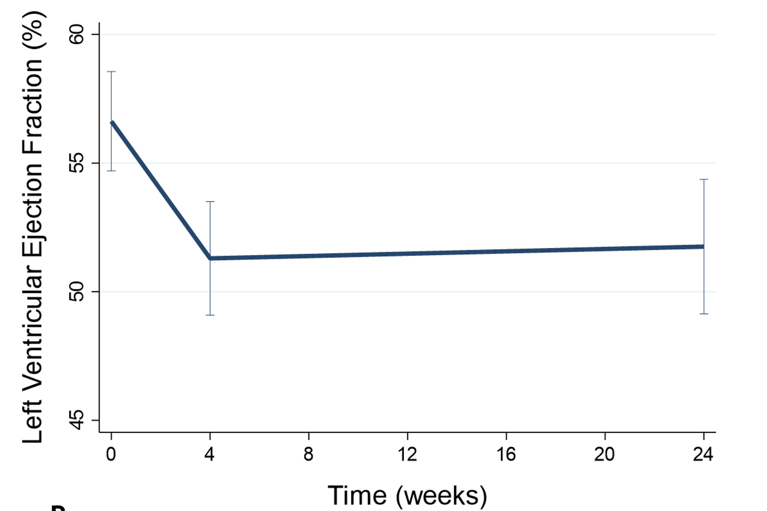
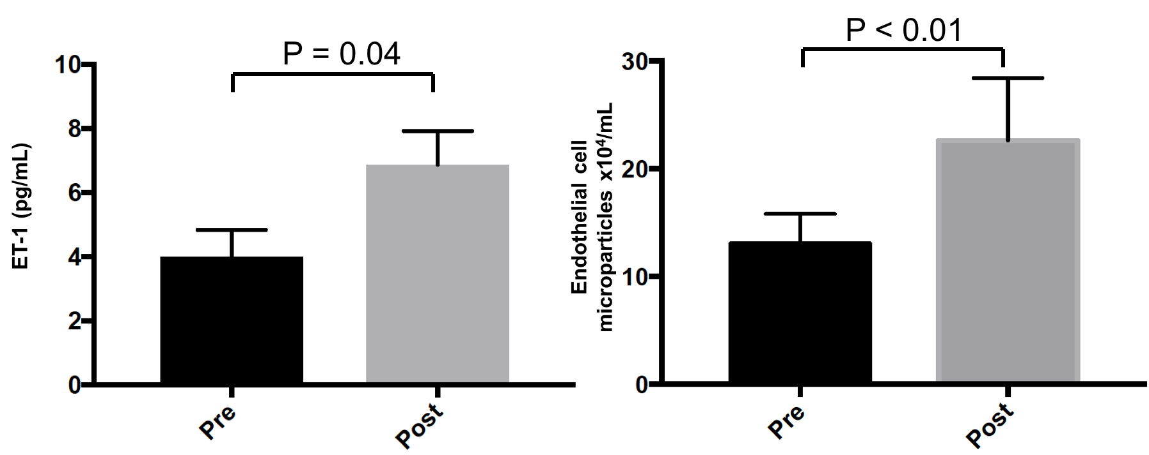
Cardiac MRI in Patients Treated with VEGFi (n=46)
A Role for Endothelin-Receptor Antagonism?
Dobbin SJ, Lang NN. Unpublished.
(NB Zibotentan initially used for treatment of renal cancer)
Neves et al. Cardiovasc Research 2019

Slide 11
KEY MESSAGES:
We need to keep up with oncology survivorship success
Microvascular dysfunction is relevant and recognized in cardio-onc definitions and guidelines
Microvascular dysfunction associated with ‘conventional’ cancer treatments…
… and now more so with ‘targeted’ therapies inc. VEGF inhibitors (and others)
Big gaps remain in understanding prevention and treatment strategies
… need mechanistic targeting (eg ET-1 antagonism, and others)
Microvascular dysfunction associated with cancer therapies might serve as a model to understand these issues in the non-cancer population

Slide 12
Thank You!

